Slide 1
Instructions
Duplicate template
Replace title and lines
Resize line under title – should be 0.3” height
Resize lines (18 or 16 font) and align text box to bottom of line
Add picture and send to back
Lower the picture where you want it
Crop the top
Add technology icons

Slide 2





Icons

Slide 3
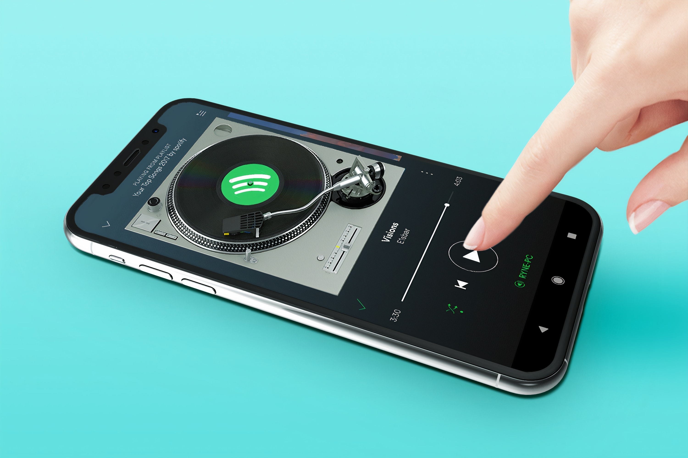
Title
Line 1 Line 2 Line 3

Slide 4
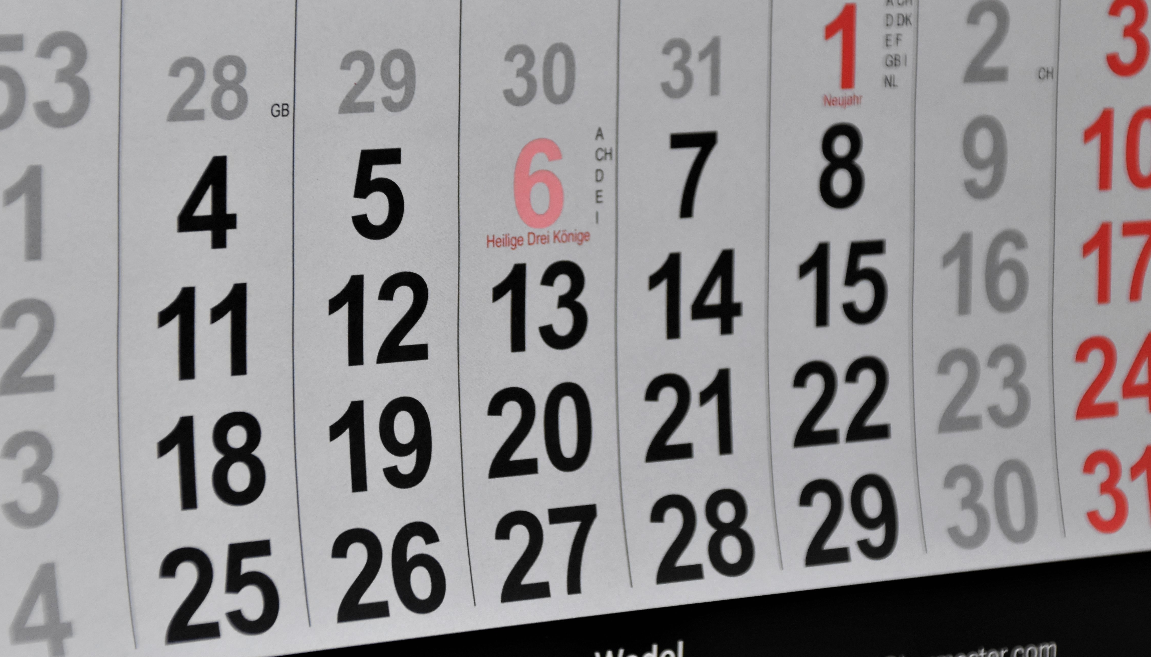
100 Days of Projects
Details of my journey with completing
100 days of complex coding projects in Python

Slide 5
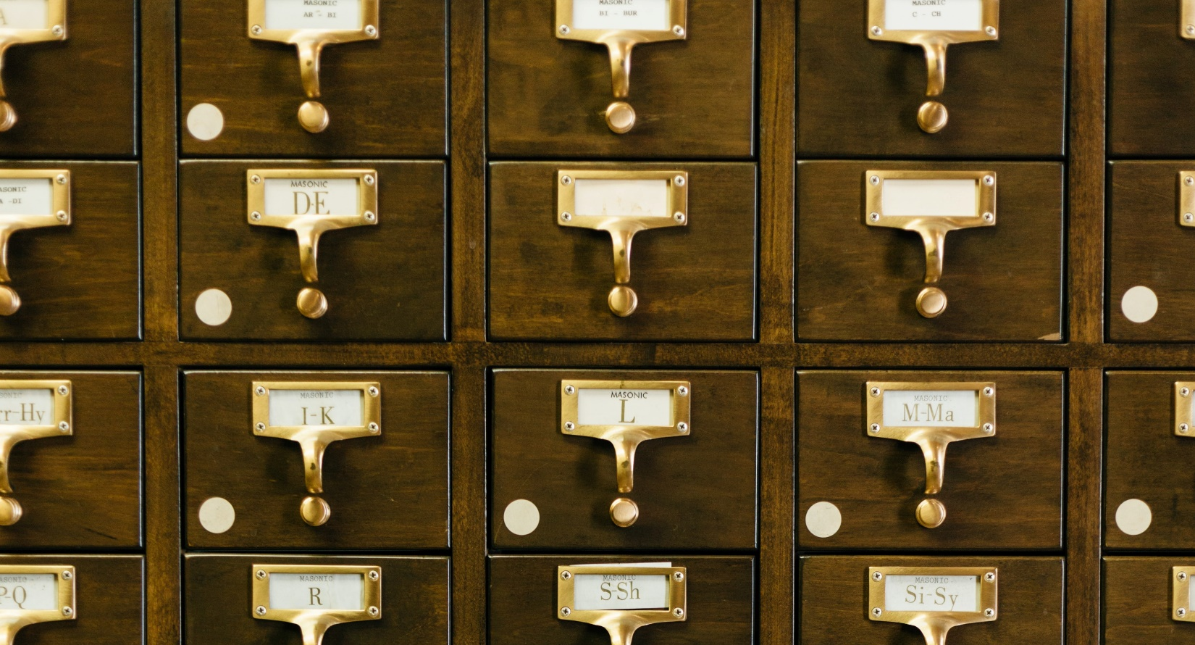
Mini-Projects
A collection of projects that explore a variety of topics on a smaller scale

Slide 6
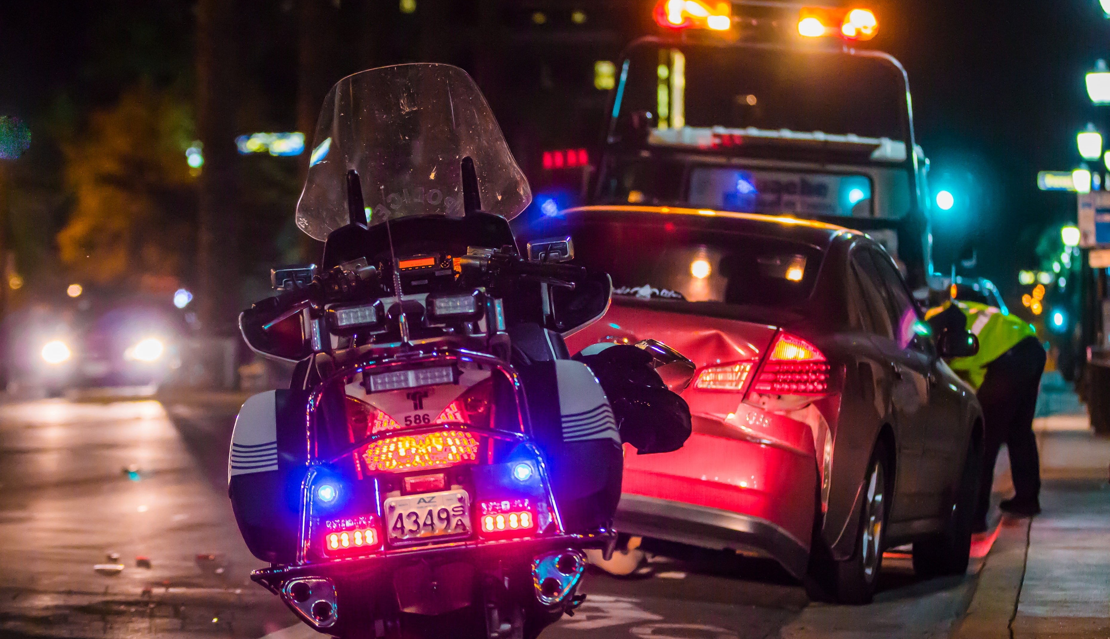
Seattle Car Accident Data
Analyzing car accident data with MySQL for data exploration and Tableau for Visuals

Slide 7
Recommending Songs on Spotify
Using logistic regression to create a recommendation model for songs using SciKit-Learn, Pandas and SciPy through Python

